Slide 1
Optimizing Lennard-Jones Structures

Slide 2
This project was adapted from the following project in: Fundamentals of Differential Equations. Eighth Edition. Nagle, Saff, and Snider. Pg. 151-152

Slide 3
Background

Slide 4

$$\sum_{i<j}^{n}{\frac{1}{{r_{ij}}^{12}}}−\frac{2}{{r_{ij}}^{6}}$$ $$r_{ij}=\sqrt{{\left(x_{i}−x_{i}\right)}^{2}+{\left(y_{i}−y_{i}\right)}^{2}+{\left(z_{i}−z_{i}\right)}^{2}}$$
Lennard Jones Potential
More information: https://en.wikipedia.org/wiki/Lennard-Jones_potential

Slide 5
Jacobian?
Hessian?

Slide 6

$$\sum_{i<j}^{n}{\frac{1}{{R_{ij}}^{6}}}−\frac{2}{{R_{ij}}^{3}}$$ $$R_{ij}={\left(x_{i}−x_{i}\right)}^{2}+{\left(y_{i}−y_{i}\right)}^{2}+{\left(z_{i}−z_{i}\right)}^{2}$$
Redefining for Simplicity…
$$R_{ij}={\left(x_{i}−x_{i}\right)}^{2}+{\left(y_{i}−y_{i}\right)}^{2}+{\left(z_{i}−z_{i}\right)}^{2}$$
More information: https://en.wikipedia.org/wiki/Lennard-Jones_potential

Slide 7

$$\left\langle \left[\sum_{i<j, i≠1}^{n}{\frac{1}{{R_{ij}}^{6}}}−\frac{2}{{R_{ij}}^{3}}\right]+\left[\sum_{j=2}^{n}{\left[\frac{−6}{{R_{1j}}^{7}}+\frac{6}{{R_{1j}}^{4}}\right]}∗2\left(x_{1}−x_{j}\right)\right], …\right\rangle$$ $$R_{ij}={\left(x_{i}−x_{i}\right)}^{2}+{\left(y_{i}−y_{i}\right)}^{2}+{\left(z_{i}−z_{i}\right)}^{2}$$
The Jacobian…

Slide 8
The Jacobian appears somewhat cumbersome…
We’ll avoid the Hessian.

Slide 9
General Strategy
Unwrap 3D coordinates into a 1D vector.
Use two points 1 unit apart as a starting structure for n=2.
For some number of initial guesses:
Guess 1 random point, append to the previous structure.
Run minimizer to obtain approximate solution.
Save structure with minimum energy.
Use structure with lowest energy as initial guess for n + 1.

Slide 10
Steepest descent with Weakest Line Search:
Fails to:
Find the minimum structure for even very small n
Do so in a reasonable amount of time…

Slide 11
Are we out of luck?

Slide 12
A Jacobian Free Method: Nelder-Mead
Brief Description:
Finds local minima by rolling a simplex
(n-dimensional triangular structure) down to a minimum.
Also called amoeba method.
More information: https://en.wikipedia.org/wiki/Nelder%E2%80%93Mead_method

Slide 13
Nelder-Mead
Not very effective…
More information: https://en.wikipedia.org/wiki/Nelder%E2%80%93Mead_method

Slide 14
Steepest descent with Weakest Line Search:
Two optimizations that make the method converge:
Ensure the initial guess has a reasonable resulting energy.
Shift the structure back to the origin after every minimization.

Slide 15
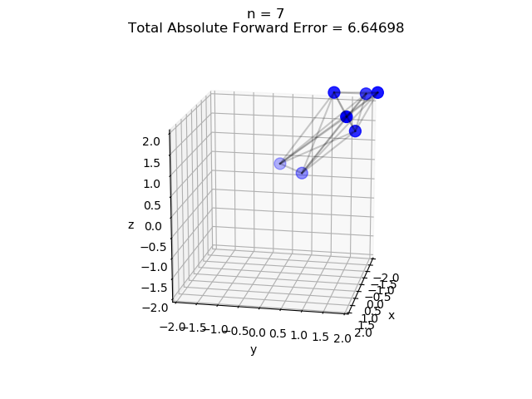
Runaway Structure

Slide 16
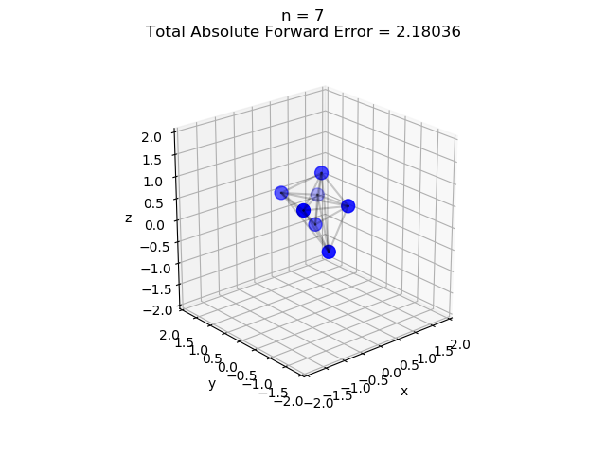
Bad Structure

Slide 17
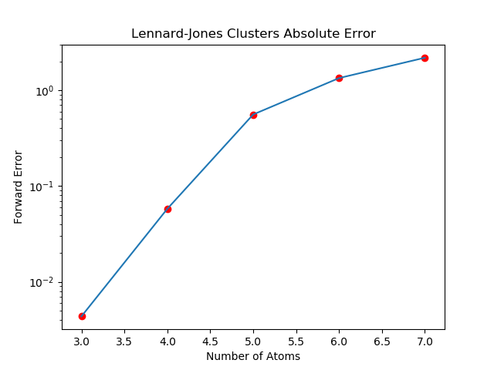
Bad Errors

Slide 18
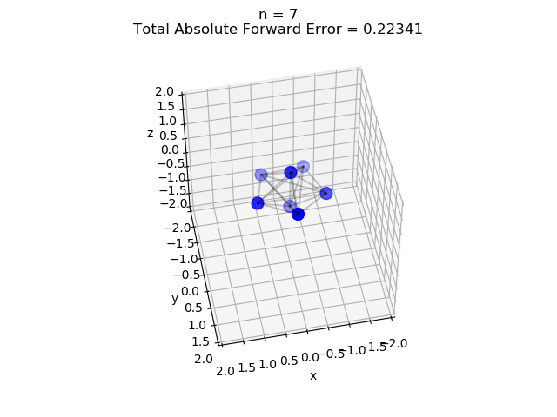
Better Structure

Slide 19
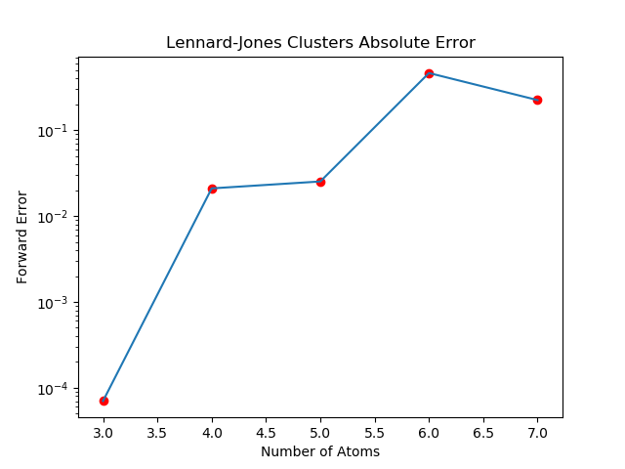
Better Errors

Slide 20
Comparison of Structures

Slide 21
Comparison of Errors

Slide 22
A lot of things didn’t work:
Steepest Descent with Golden Section Search (Didn’t converge)
Nelder-Mead
Using completely random initial guesses.

Slide 23
Factors that led to improvement:
Throwing out guesses with wildly inaccurate energies
Changing the bounds for the random guesses
Shifting structures back to the origin

Slide 24
But does the tolerance affect the accuracy?

Slide 25
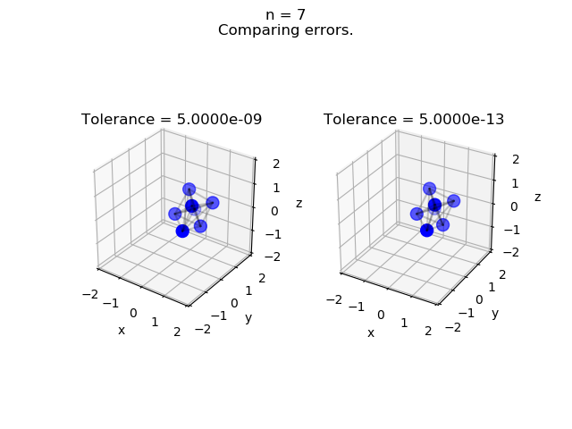
Comparing Structures by Tolerance

Slide 26
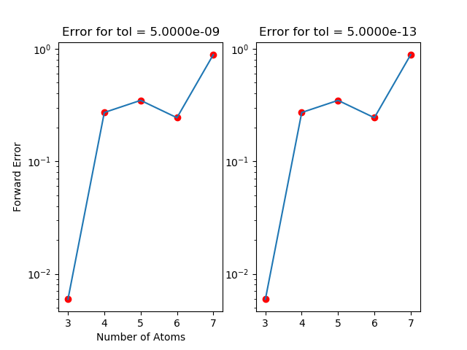
Comparing Errors by Tolerance

Slide 27
…Not by a significant amount.
(A difference is seen starting at approximately the 12th digit of the potential energy.)

Slide 28
What do the other structures look like?

Slide 29
Why are some structures so hard to get the right shape for?

Slide 30
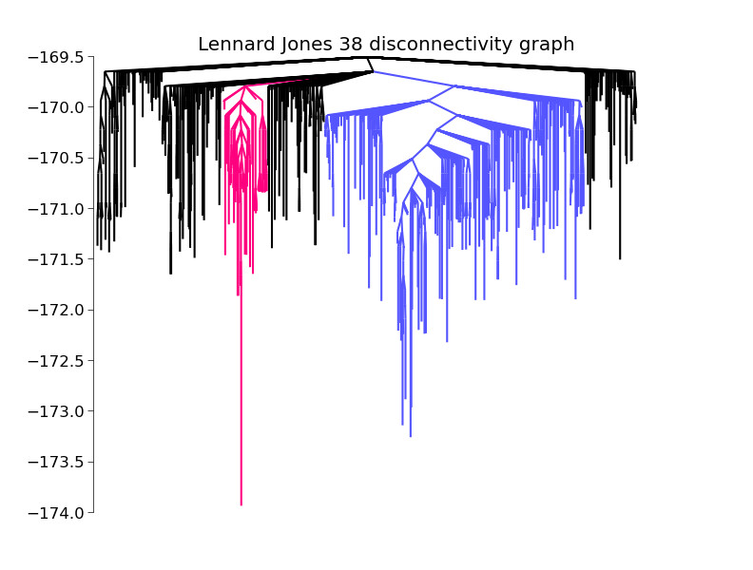
Disconnectivity Graph
Source: http://pele-python.github.io/pele/disconnectivity_graph.html

